Slide 1
The Future of Quantum Supremacy Experiments
Scott Aaronson (UT Austin / OpenAI)
Q2B, Santa Clara, CA, December 5, 2023

Slide 2
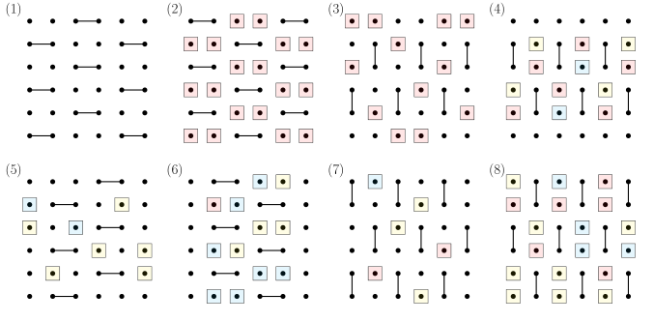
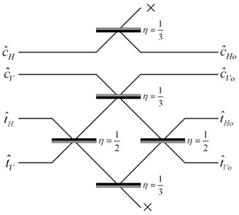
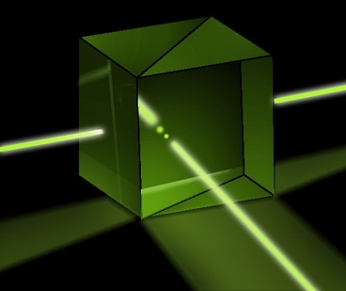
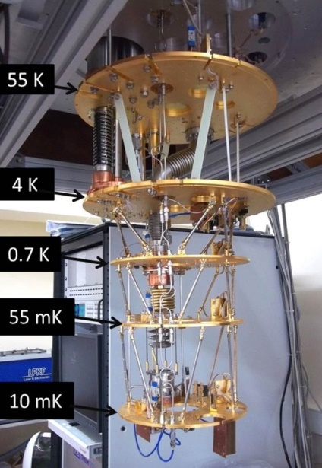
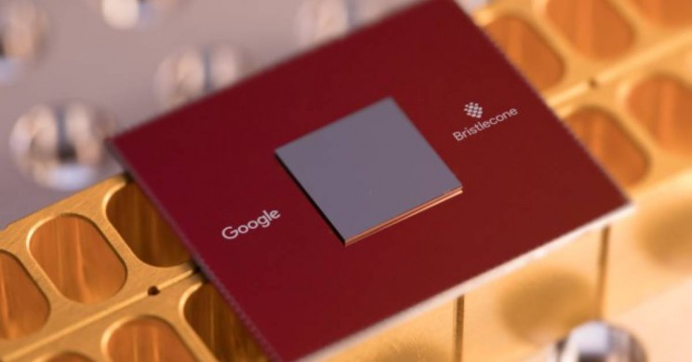
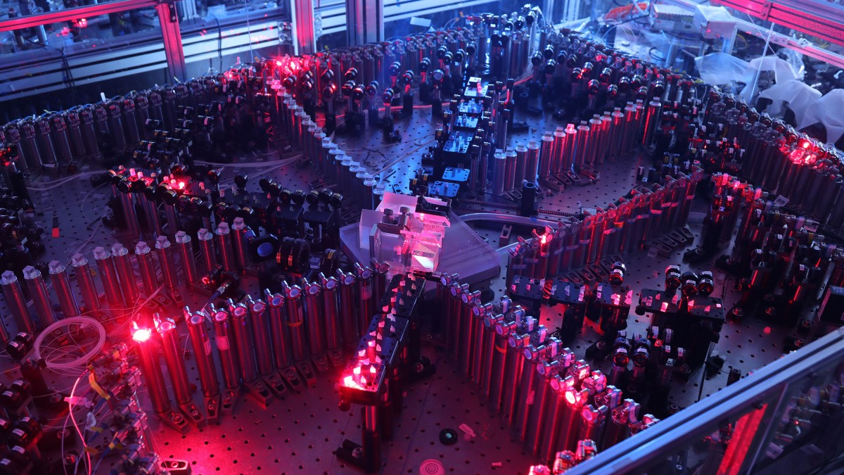
Quantum Supremacy Experiments Now
Random Circuit Sampling (53-qubit experiment by Google team 2019; another by USTC team 2020)
BosonSampling (A.-Arkhipov 2011, ~100-photon experiments by USTC team 2020, Xanadu 2022)

Slide 3
What’s Wrong With the Current Supremacy Experiments?
Lack of error-correction prevents scaling: Obvious.
Spoofing attacks:
Pan-Chen-Zhang 2021: Tensor network contraction
Gao-Kalinowski-Chou-Lukin-Barak-Choi 2021: Gets 1/exp(depth) advantage on Linear Cross Entropy Benchmark (XEB)
Most fundamental (in my view): Exponential time needed for classical verification!! (E.g. via Linear XEB)

Slide 4
Field Guide to Big Quantum Speedups
QAOA
NISQy
Efficiently
Verifiable
Quantum machine learning
?
Shor
Mahadev
BosonSampling
Yamakawa-Zhandry
Random Circuit Sampling
Physics simulations
In-Principle Quantum Advantage

Slide 5
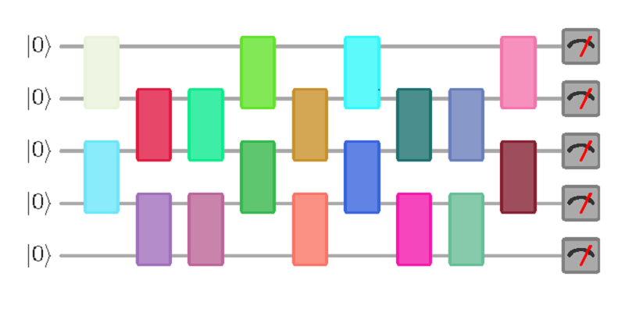
New Open Question
Call a quantum circuit C “peaked” if |⟨x|C|0^{n}⟩|²≥0.1 for some basis state |x⟩.
(More generally: if C|0^{n}⟩ has any nonrandom features easy to notice on measurement)
What does a uniformly random peaked circuit with (say) n qubits and m=n² gates look like? Just a bunch of gates and then their inverses? Pseudorandom?
|0⟩
|0⟩
vs.
U
U⁻¹
|0⟩
(obfuscated)

Slide 6
More Questions
Given an n-qubit, m-gate random quantum circuit, how many more gates must we add to get a peaked circuit?
Even an upper bound of e.g., m/2 would be exceedingly interesting for quantum advantage experiments!
What fraction of quantum circuits are peaked?
How hard is it to sample a random peaked circuit? What about a peaked circuit that’s hard to distinguish from random?

Slide 7
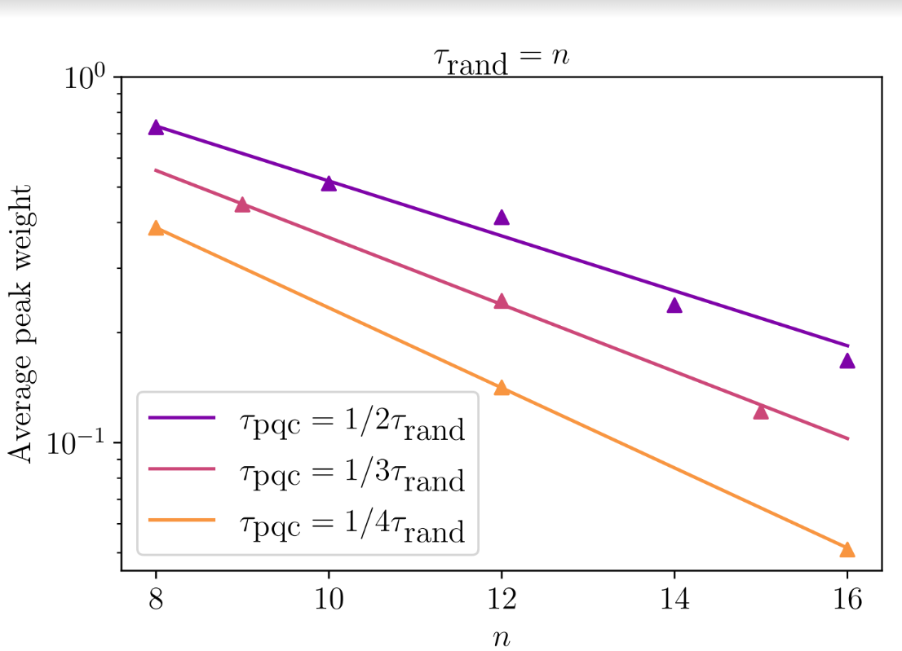
Preliminary Data on Peakedness (SA and Yuxuan Zhang)

Slide 8
Hardness of Simplification
Clément, Heurtel, Mansfield, Perdrix, Valiron, June 2022: Complete equational theory for quantum circuits
Solved a longstanding problem! (Previously: ZX-calculus)
More questions relevant to quantum advantage:
Are there poly-size quantum circuits that implement the identity, but take exponentially many rewrites to simplify to the identity (or to any classical circuit)?
Where one does/doesn’t have to pass through intermediate circuits of exponential size?

Slide 9
“Quantum Information Supremacy” Aaronson-Buhrman-Kretschmer 2023
A new type of quantum supremacy experiment, which wouldn’t depend on any unproved complexity assumptions
Goal: Experimentally check that, if Nature is “secretly maintaining a classical description” for an n-qubit entangled state |ψ⟩, even a probabilistic one, that description must contain >>n classical bits to account for the outcomes of all possible measurements on |ψ⟩
E.g., if n=20, check that >100 classical bits are needed
How? By using exponential separations between quantum randomized one-way communication complexity

Slide 10
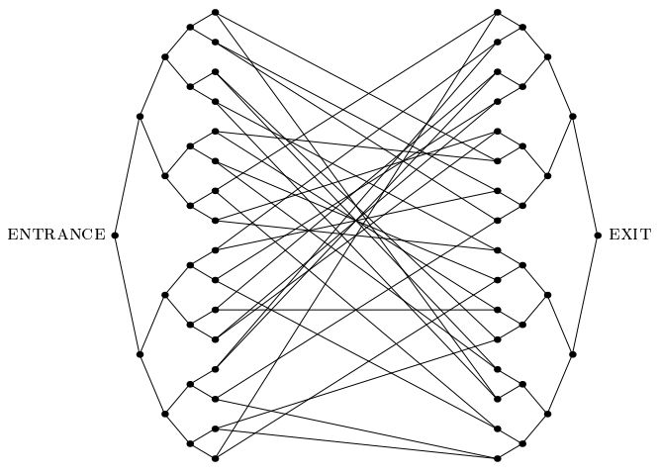
Summary
Exponential quantum speedups that are easily verifiable classically tend to be “weird” and “finely tuned”
If we want to demonstrate one on a NISQ device, we need to make it as “generic” as possible
There’s always quantum simulation…!

